Slide 1

Machine Learning Systems Design
Lecture 5: Scaling Up Training
CS 329S | Karan Goel

Slide 2
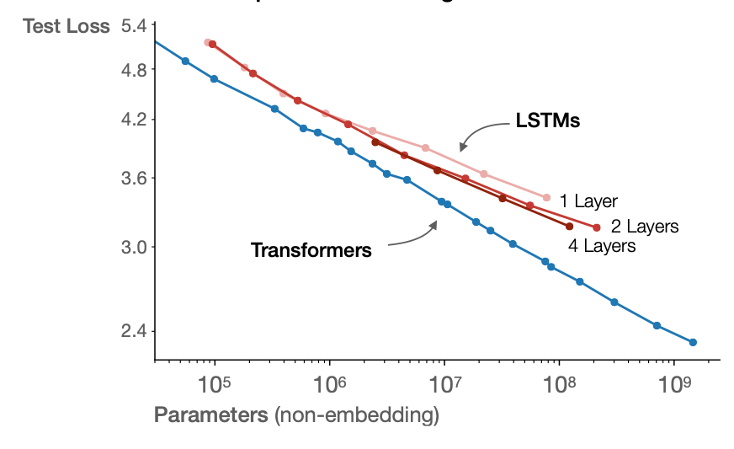
Motivation
Scale!
Larger models + more data
→ stronger performance
170 billion
Credit: Scaling Laws for Neural Language Models

Slide 3
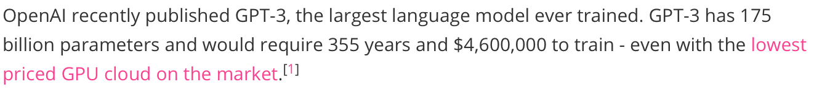
need distributed training!
Credit: Chuan Li, https://lambdalabs.com/blog/demystifying-gpt-3/

Slide 4
Main Ingredients
Parameters
Compute
Data

Slide 5
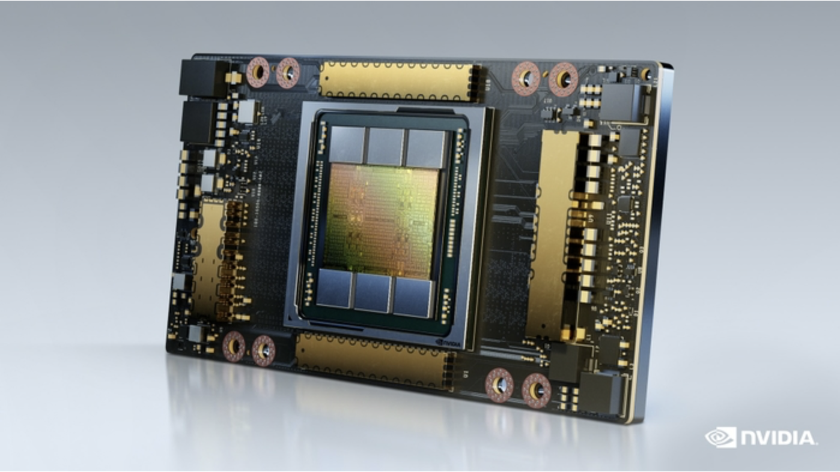
Main Bottleneck: GPU Memory
Model Training
Load the model
Load in a minibatch of data
Compute forward pass
Perform backpropagation
Credit: NVIDIA News

Slide 6
🚀 Parameters: Pre-training with Self-Supervision
BERT (2018)
T5 (2019)
GPT-3 (2020)
BERT-Base
110M
T5-Small
60M
GPT-3 Small
125M
BERT-Large
340M
T5-Base
220M
GPT-3 Medium
350M
T5-Large
770M
GPT-3 Large
760M
T5-11B
11B
GPT-3
175B

Slide 7
🚀 Parameters: Pre-training with Self-Supervision
BERT (2018)
T5 (2019)
GPT-3 (2020)
Switch Transformer (2021): 1 Trillion
BERT-Base
110M
T5-Small
60M
GPT-3 Small
125M
BERT-Large
340M
T5-Base
220M
GPT-3 Medium
350M
T5-Large
770M
GPT-3 Large
760M
T5-11B
11B
GPT-3
175B

Slide 8
Storing Parameters
Parameter Representation
1 B parameters @ fp16
= 10^9 x 2 bytes
= 1.86 GB
175B parameters @ fp16
= 175 x 10^9 x 2 bytes
= 316.2 GB
32 bit float (float32, fp32)
16 bit float (float16, fp16)
8 bit int unsigned (uint8)
Note: some parameters must be in float32 for numerical stability

Slide 9

80 GB < 316.2 GB
Credit: NVIDIA News

Slide 10
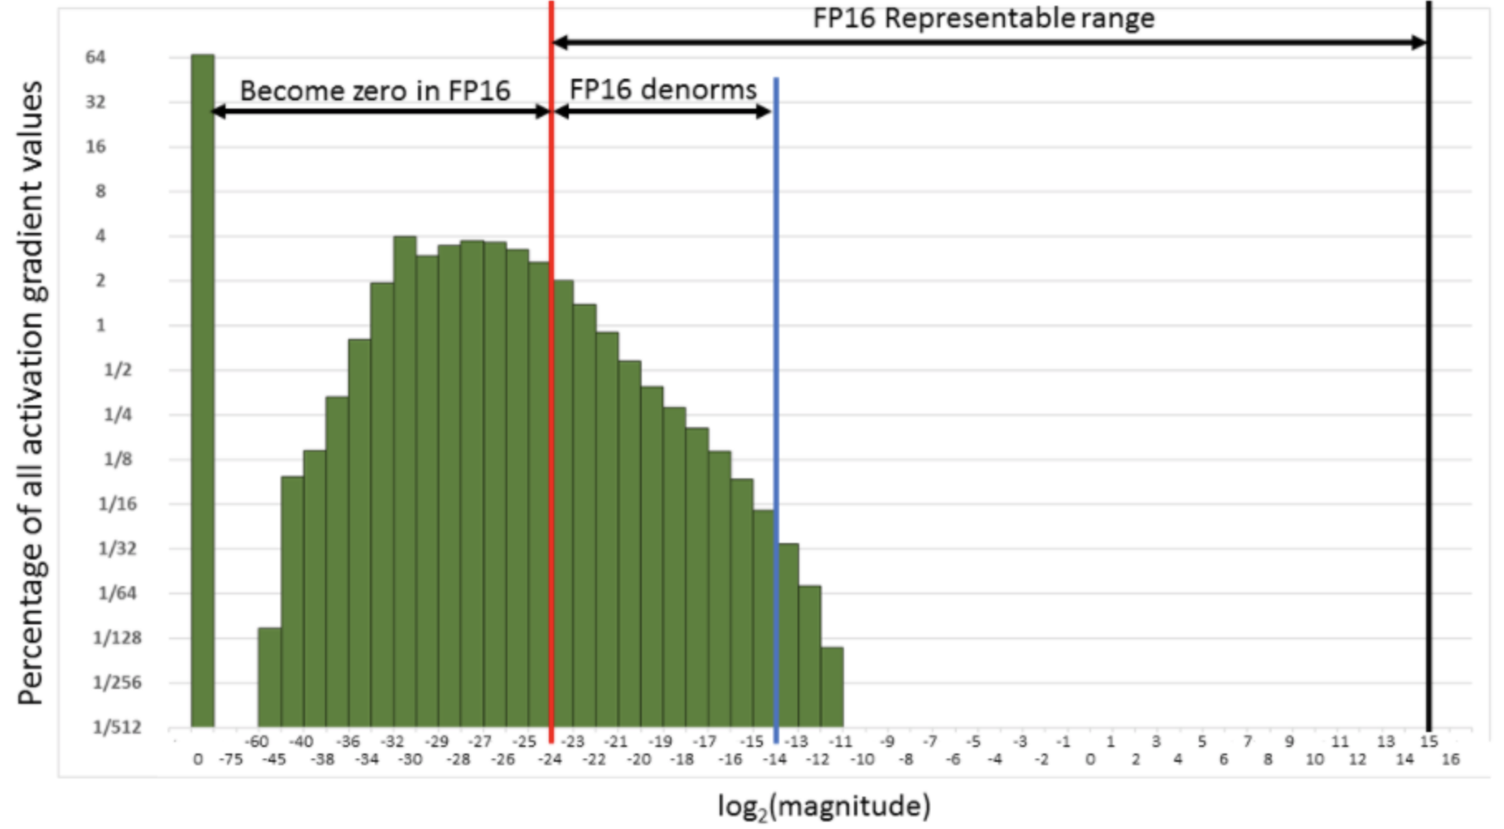
Mixed-Precision Training: Loss Scaling
MIXED PRECISION TRAINING (Narang et al., ICLR 2018)

Slide 11
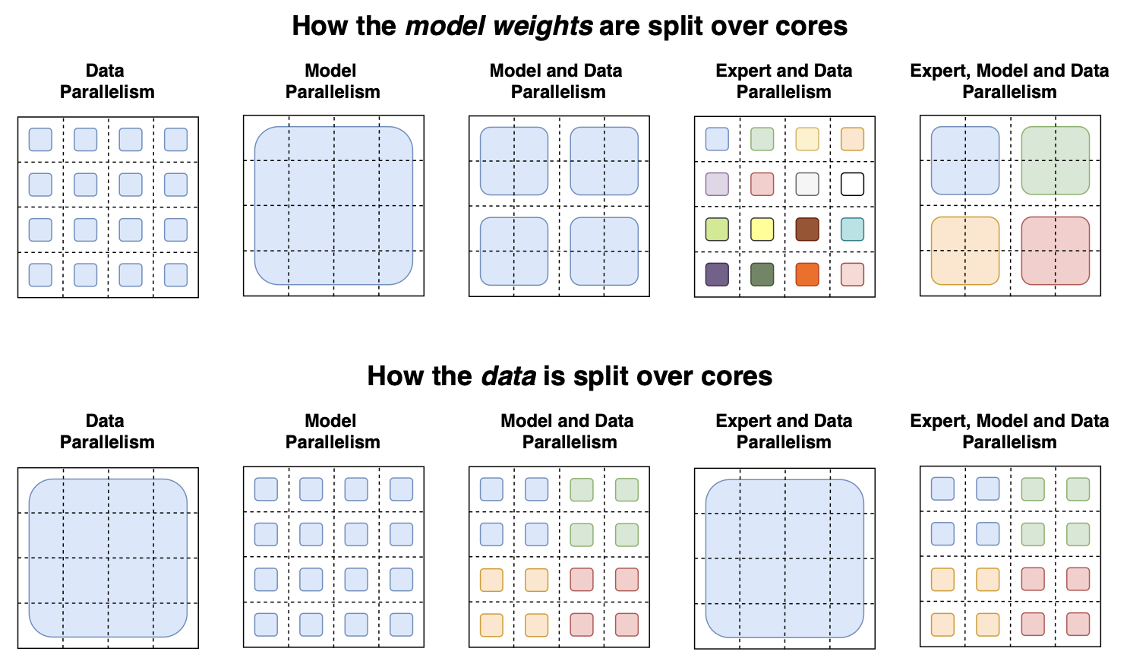
Solution: Model Parallelism for Large Model Training
split the model across devices
each device runs a fragment of the model
Credit: Fedus et al. (Switch Transformers: Scaling to Trillion Parameter Models with Simple and Efficient Sparsity

Slide 12
Pipeline Parallelism
Distributed Tensor Computation
GPU 1
GPU 1
GPU 2
GPU 2

Slide 13
Model Parallelism: Naive
GPU 1
GPU 2
GPU 3
GPU 4

Slide 14
Model Parallelism: Naive
GPU 1
GPU 2
GPU 3
GPU 4

Slide 15
Model Parallelism: Naive
GPU 1
GPU 2
GPU 3
GPU 4
idle

Slide 16
Model Parallelism: Naive
GPU 1
GPU 2
GPU 3
GPU 4
idle
idle

Slide 17
Model Parallelism: Naive
GPU 1
GPU 2
GPU 3
GPU 4
idle
idle
idle

Slide 18
Pipeline Parallelism
GPU 1
GPU 2
GPU 3
GPU 4
key idea: split mini-batch into sequential micro-batches

Slide 19
Pipeline Parallelism
GPU 1
GPU 2
GPU 3
GPU 4

Slide 20
Pipeline Parallelism
GPU 1
GPU 2
GPU 3
GPU 4

Slide 21
Pipeline Parallelism
GPU 1
GPU 2
GPU 3
GPU 4

Slide 22
Storing Activations
Forward activations
major source of memory usage
memory usage = minibatch size x # parameters

Slide 23
Solution 1: Gradient Checkpointing
GPU 1
key idea: trade-off memory for compute

Slide 24
Solution 1: Gradient Checkpointing
GPU 1
don’t store some activations in forward pass

Slide 25
GPU 1
backpropagate

Slide 26
GPU 1
don’t have activations!

Slide 27
GPU 1
recompute activations from checkpoint

Slide 28
GPU 1
backpropagate

Slide 29
GPU 1
backpropagate

Slide 30
GPU 1
backpropagate

Slide 31
GPU 1
backpropagate

Slide 32
GPU 1
backpropagate

Slide 33
GPU 1
backpropagate

Slide 34
“For feed-forward models we were able to fit more than 10x larger models onto our GPU, at only a 20% increase in computation time.”
Credit: https://github.com/cybertronai/gradient-checkpointing

Slide 35
Solution 2: Data Parallelism for Large Batch Training
split the data across devices
each device sees a fraction of the batch
each device replicates the model
each device replicates the optimizer

Slide 36
replicate model across devices
GPU 1
GPU 2
GPUs could be on same or multiple nodes

Slide 37
to push in a batch of data
GPU 1
GPU 2

Slide 38
split batch across devices
GPU 1
GPU 2

Slide 39
parallel forward passes
GPU 1
GPU 2

Slide 40
parallel forward passes
GPU 1
GPU 2

Slide 41
GPU 1
GPU 2
backpropagate gradients

Slide 42
GPU 1
GPU 2
backpropagate gradients

Slide 43
GPU 1
GPU 2
all-reduce operation

Slide 44
GPU 1
GPU 2
all devices do the same gradient updates

Slide 45
GPU 1
GPU 2
all parameters stay synchronized!

Slide 46
Trick: Gradient Bucketing
interleave communication with computation
synchronize buckets of gradients

Slide 47
Collective Communication
single- and multi-node communication

Slide 48
Collective Communication
single- and multi-node communication
Message Passing Interface (MPI)
Sets standard + CPU-CPU communication
synchronization, data movement, reduction
nVidia Collective Communications Library (nccl)
Follows MPI standard for GPU-GPU communication
Facebook Gloo
Optimized for ML: CPU-CPU/GPU-GPU communication

Slide 49
Inter-Process Communication: The All-Reduce
all-reduce operation
p processes
each process has tensor of size n
tensors aggregated (e.g. sum)
result returned to each process

Slide 50
Naive All-Reduce
GPU 1
tensor 1
GPU 3
GPU 2
tensor 3
tensor 2

Slide 51
Naive All-Reduce
GPU 1
tensor 1
GPU 3
GPU 2
tensor 3
tensor 2
everyone sends everyone their tensor

Slide 52
Naive All-Reduce
GPU 1
tensor 1
GPU 3
GPU 2
tensor 3
tensor 2
everyone sends everyone their tensor

Slide 53
Naive All-Reduce
GPU 1
tensor 1
tensor 3
tensor 2
GPU 3
GPU 2
tensor 3
tensor 2
tensor 2
tensor 1
tensor 1
tensor 3

Slide 54
Naive All-Reduce
GPU 1
tensor 1
tensor 2
tensor 2
GPU 3
GPU 2
tensor 3
tensor 2
tensor 1
tensor 1
tensor 1
tensor 3

Slide 55
Naive All-Reduce
GPU 1
tensor 1
total work = p senders x (p - 1) receivers x o(n) tensor = o(np²)
everyone does o(np) work
tensor 2
tensor 2
GPU 3
GPU 2
tensor 3
tensor 2
tensor 1
tensor 1
tensor 1
tensor 3

Slide 56
Another Naive All-Reduce
GPU 1
tensor 1
GPU 3
GPU 2
tensor 3
tensor 2
everyone sends their tensor to a designated manager

Slide 57
Another Naive All-Reduce
GPU 1
tensor 1
GPU 3
GPU 2
tensor 3
tensor 2
everyone sends their tensor to a designated manager

Slide 58
Another Naive All-Reduce
GPU 1
tensor 1
tensor 3
tensor 2
GPU 3
GPU 2
manager does the reduce

Slide 59
Another Naive All-Reduce
GPU 1
tensor 1
tensor 2
tensor 2
GPU 3
GPU 2
manager sends result back to everyone else

Slide 60
Another Naive All-Reduce
GPU 1
tensor 1
tensor 2
tensor 2
GPU 3
GPU 2
tensor 3
tensor 2
tensor 1
tensor 1
tensor 1
tensor 3

Slide 61
Another Naive All-Reduce
GPU 1
total work = (p-1) x 2 transfers x o(n) tensor = o(np)
manager does o(np) work
tensor 1
tensor 2
tensor 2
GPU 3
GPU 2
tensor 3
tensor 2
tensor 1
tensor 1
tensor 1
tensor 3

Slide 62
Ring All-Reduce
GPU 1
tensor 1
GPU 3
GPU 2
tensor 3
tensor 2

Slide 63
Ring All-Reduce
GPU 1
1
2
3
GPU 3
GPU 2
1
2
3
1
2
3
split tensor into p chunks

Slide 64
Ring All-Reduce
GPU 1
1
2
3
GPU 3
GPU 2
1
2
3
1
2
3
share a chunk

Slide 65
Ring All-Reduce
GPU 1
2
3
+
2
GPU 3
GPU 2
1
2
1
3
+
+
reduce locally
1
3

Slide 66
Ring All-Reduce
GPU 1
2
3
2
GPU 3
GPU 2
1
2
1
3
1
3
reduce locally

Slide 67
Ring All-Reduce
GPU 1
2
3
2
GPU 3
GPU 2
1
2
1
3
1
3
share reduced chunk

Slide 68
Ring All-Reduce
GPU 1
3
+
3
3
GPU 3
GPU 2
2
1
+
+
reduce locally
2
1
2
1

Slide 69
Ring All-Reduce
GPU 1
3
3
3
GPU 3
GPU 2
2
1
2
1
2
1
everyone has a chunk of the result after (p-1) share-reduce steps

Slide 70
Ring All-Reduce
GPU 1
3
3
3
GPU 3
GPU 2
2
1
2
1
2
1
share reduced chunk

Slide 71
Ring All-Reduce
GPU 1
1
3
1
3
1
3
GPU 3
GPU 2
2
3
1
2
2
3
1
2
2
3
1
2

Slide 72
Ring All-Reduce
GPU 1
1
3
1
3
1
3
GPU 3
GPU 2
2
3
1
2
2
3
1
2
2
3
1
2
share reduced chunk

Slide 73
Ring All-Reduce
GPU 1
1
2
3
1
2
3
1
2
3
GPU 3
GPU 2
1
2
3
1
2
3
1
2
3
1
2
3
1
2
3
1
2
3

Slide 74
Ring All-Reduce
GPU 1
total work = p senders x 1 receiver x o(n/p) tensor x (p-1) rounds x 2 phases = o(np)
everyone does equal o(n) work (independent of p!)
1
2
3
1
2
3
1
2
3
GPU 3
GPU 2
1
2
3
1
2
3
1
2
3
1
2
3
1
2
3
1
2
3

Slide 75

Ring All-Reduce
nVidia Collective Communications Library (nccl)
Horovod distributed training

Slide 76
Credit: Fedus et al. (Switch Transformers: Scaling to Trillion Parameter Models with Simple and Efficient Sparsity)

Slide 77
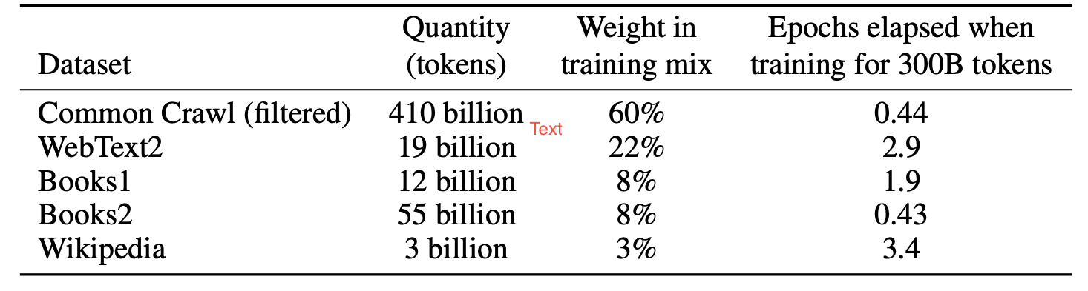
Large-Scale Data in Language Modeling
Credit: Brown et al. (Language Models are Few-Shot Learners)

Slide 78
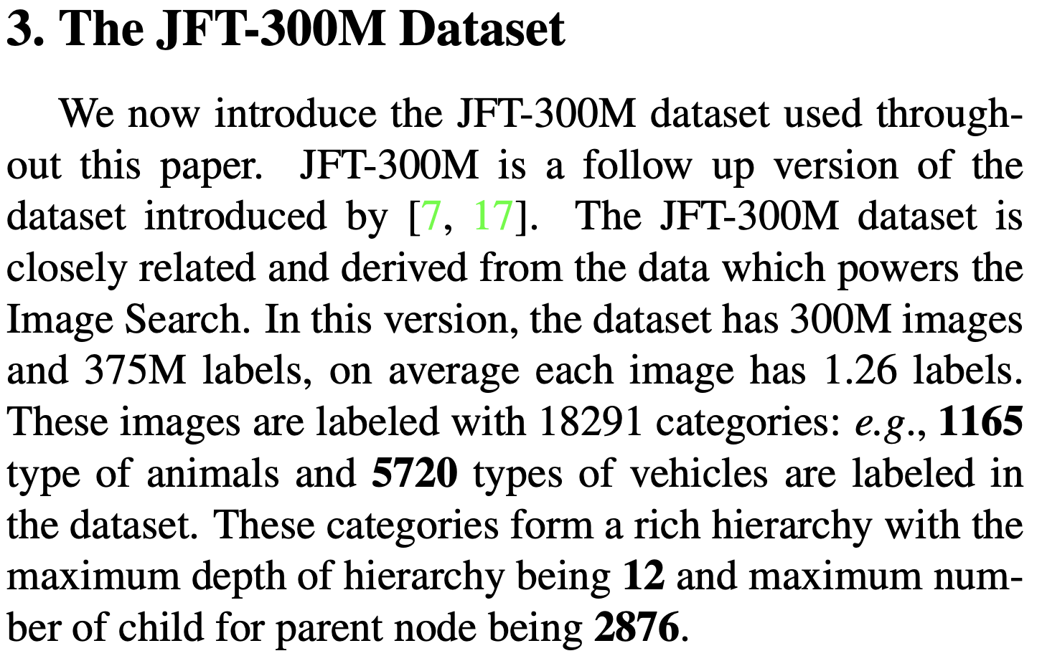
Large-Scale Data in Visual Learning
Credit: Sun et al. (Revisiting Unreasonable Effectiveness of Data in Deep Learning Era)

Slide 79


Feed Data Fast
Columnar Data
Apache Parquet (Disk)
Apache Arrow (In-Memory)
Parallel Workers
Apache Spark
Multiprocessing
Multithreading
Libraries
HuggingFace Datasets
Uber Petastorm
Tensorflow Datasets
Warning: primary memory is a bottleneck!

Slide 80


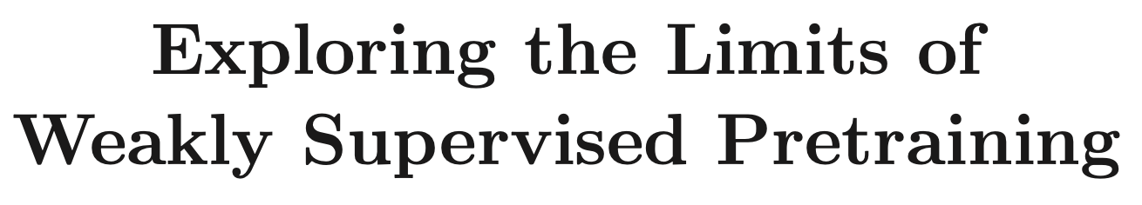
Lots More To Read

Slide 81






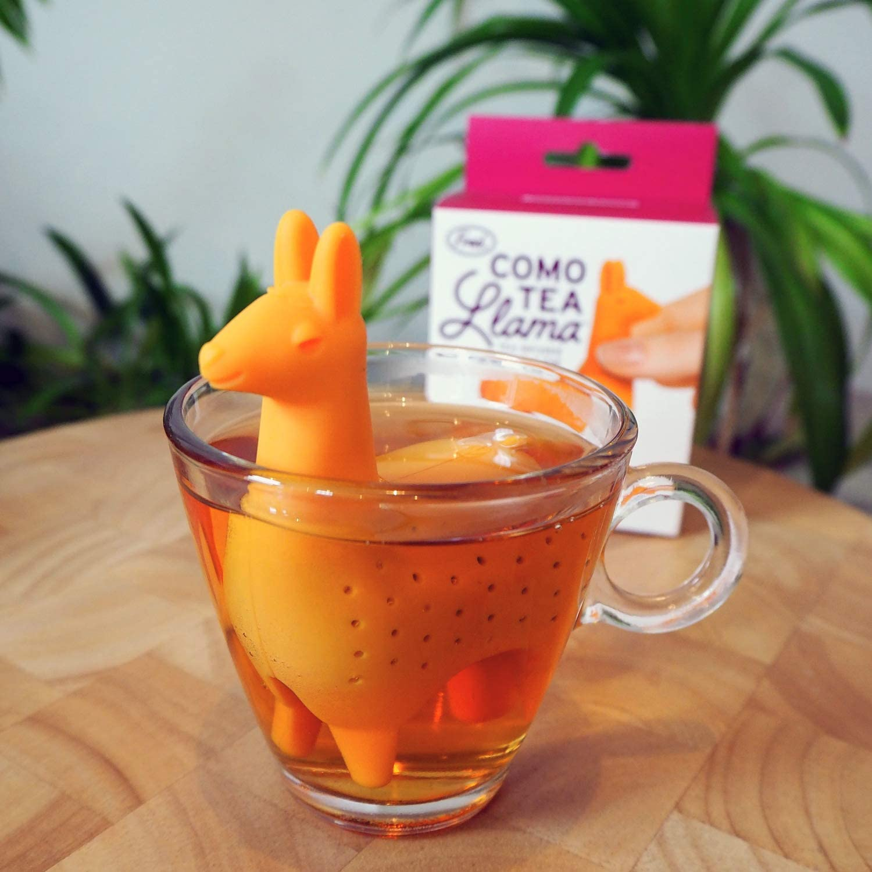

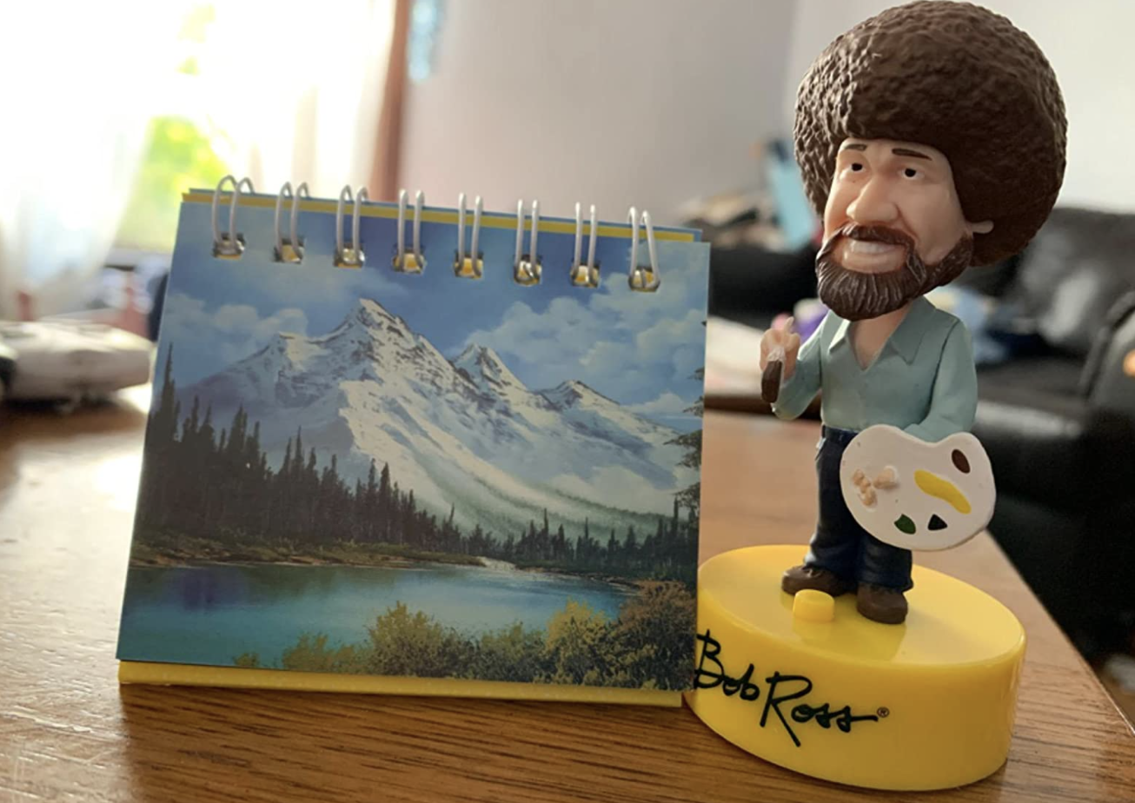

1 2 9 4 5
3 6 7 8 10

Slide 82
Machine Learning Systems Design
Next class: Model evaluation
cs329s.stanford.edu | Chip Huyen

